Slide 1



ProjetoIntegradoFinal2.0
View in Power BI
Last data refresh:
13/01/2021 11:03:48 E. South America Standard Time
Downloaded at:
13/01/2021 11:08:01 E. South America Standard Time

Slide 2
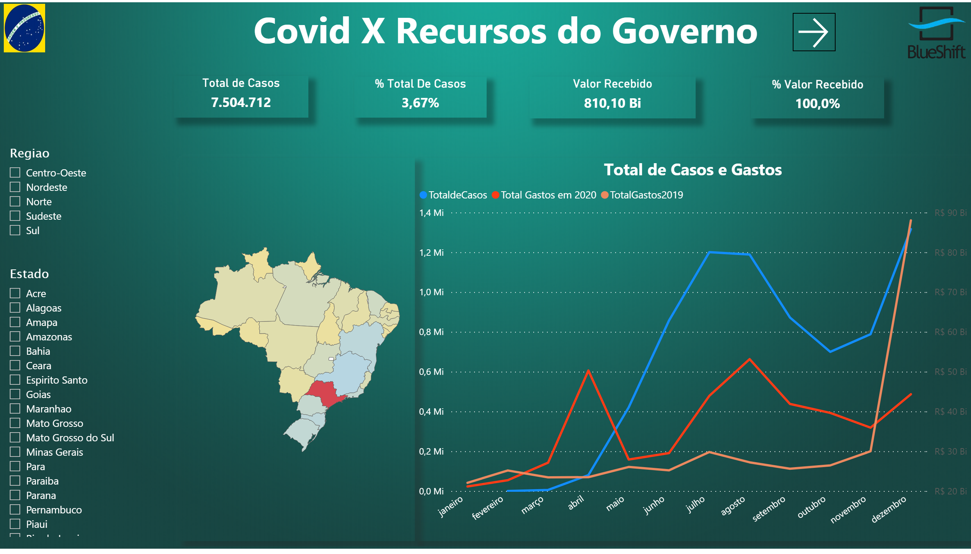
Painel.P

Slide 3
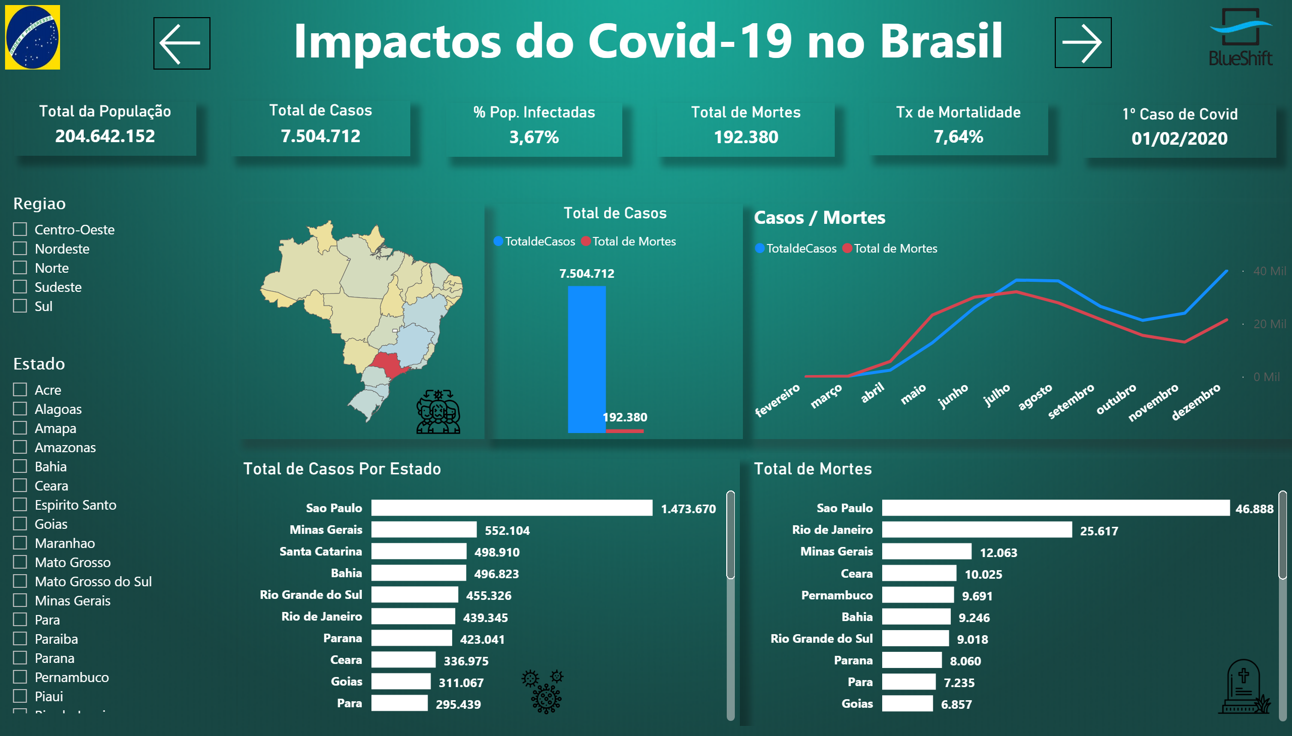
Covid

Slide 4
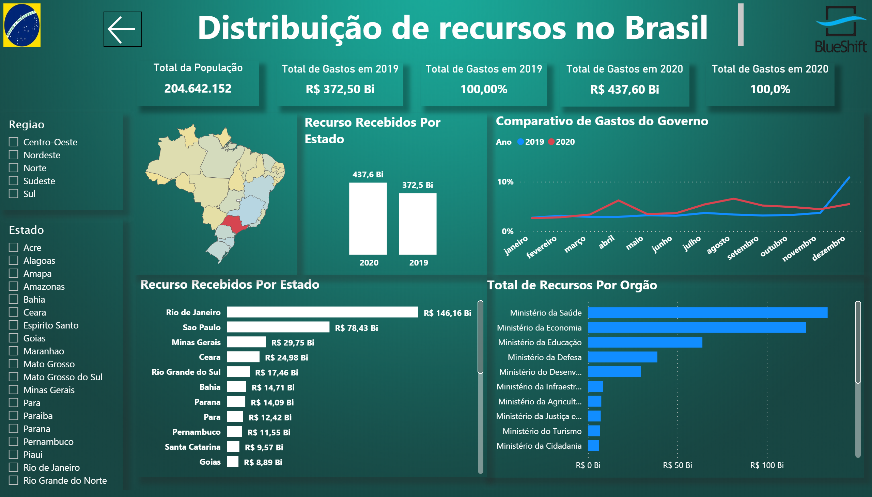
Recursos do Governo

